Slide 1

Calorie Tracking Web Application
Developed with Python, Flask, and Docker, leveraging GitHub Codespaces and GitHub Actions for a seamless development and deployment experience.
ANIKET GANGWAR , AG-1 , ROLL No. : 12515000195

Slide 2

The Challenge: Effortless Calorie Tracking
Struggling with Daily Intake
Many individuals find it difficult to accurately track their daily calorie consumption.
Manual Tracking is Inefficient
Traditional methods are often time-consuming, prone to errors, and lead to inconsistency.
Need for a Simple Web Tool
There's a clear demand for an accessible, fast, and user-friendly web application to simplify this process.
Automated Calculation is Key
The core goal is to automate calorie calculations and provide instant, reliable results to users.

Slide 3




Our Solution: An Intuitive Calorie Tracker
Our web application streamlines calorie tracking by offering a simple, yet powerful, user experience.
User Input
Users easily enter food items and their respective quantities.
Backend Calculation
A robust backend processes the input, calculating calories using a comprehensive dataset.
Instant Output
The application quickly displays the total calorie count.
The entire application is hosted within GitHub Codespaces and Dockerized for consistent behavior across all environments.

Slide 4

System Architecture: A Unified Approach
Our system design integrates modern development practices, ensuring efficiency and reliability.
Frontend
Backend
Containerization
CI/CD
Frontend: Intuitive user interface built with HTML and CSS.
Backend: Powerful data processing and API logic with Python Flask.
Containerization: Docker ensures consistent environments for development and deployment.
Deployment: Seamless cloud-based development and hosting with GitHub Codespaces.
CI/CD: Automated workflows for continuous integration and deployment using GitHub Actions.

Slide 5





The Power Behind Our Application: Tech Stack
We've carefully selected a modern and efficient tech stack to build a robust and scalable calorie tracking solution.
Programming: Python
Web Framework: Flask
The backbone of our application logic, known for its readability and extensive libraries.
A lightweight and flexible micro-framework for building our API.
Database: CSV/JSON
Containerization: Docker
Efficient storage for our comprehensive calorie dataset.
Ensures application portability and consistent execution across environments.
Cloud Dev: Codespaces
CI/CD: GitHub Actions
Provides an instant, cloud-based development environment directly from GitHub.
Automates our build, test, and deployment workflows seamlessly.

Slide 6

Development & Deployment Workflow
Our streamlined workflow integrates development, containerization, and continuous integration.
Develop Flask Application
Write the core Python Flask code for calorie calculation.
Build Docker Image
Create a Docker image from the application: docker build -t calorie-app .
Run Container Locally
Test the containerized app: docker run -p 5000:5000 calorie-app
Commit Code to GitHub
Push changes to the GitHub repository, triggering automation.
GitHub Actions CI Pipeline
Automated build and test processes initiate via GitHub Actions.
Access via Codespaces
The application becomes accessible through Codespaces' forwarded port.

Slide 7



Docker Implementation: Portability & Consistency
Docker is central to our project, providing a consistent and isolated environment for our application.
Dockerfile Structure
Key Benefits
# Use an official Python runtime as a parent imageFROM python:3.9-slim-buster# Set the working directory in the containerWORKDIR /app# Copy the current directory contents into the container at /appCOPY . /app# Install any needed packages specified in requirements.txtRUN pip install Flask# Make port 5000 available to the world outside this containerEXPOSE 5000# Run app.py when the container launchesCMD ["python", "app.py"]
Portability
Run the application identically on any system that supports Docker.
Consistency
Eliminates "works on my machine" issues by packaging dependencies.
Isolation
Applications and their dependencies are isolated from each other and the host system.

Slide 8
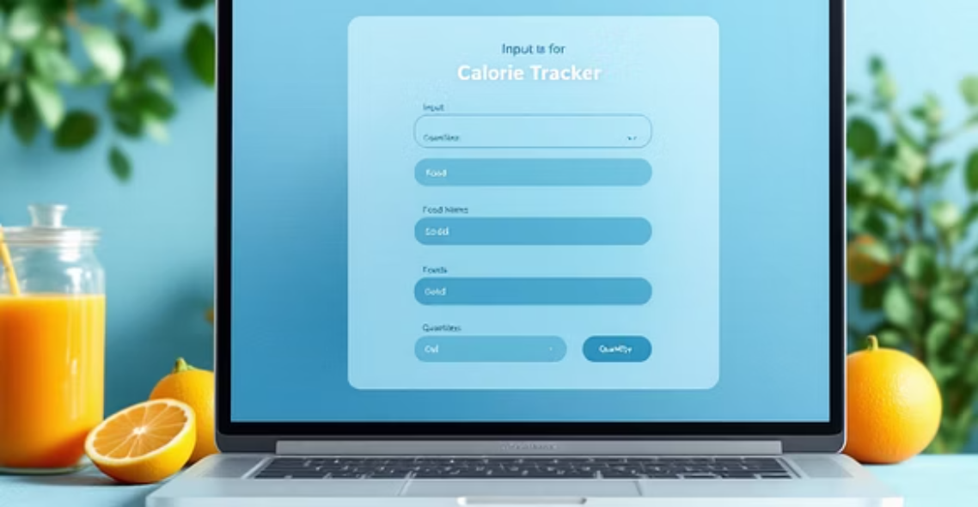
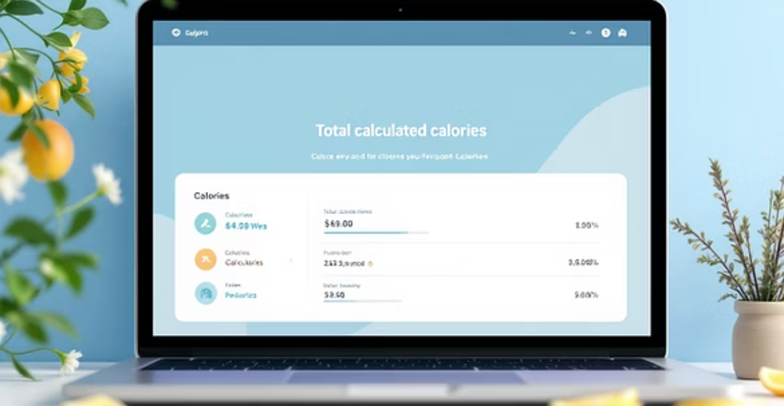


Demo Output: A Glimpse of the Application
See our calorie tracker in action, from user input to the final calorie tally, all within the Codespaces environment.
The demo highlights the application's responsiveness and the seamless integration within GitHub Codespaces, making development and testing highly efficient.

Slide 9





Conclusion: A Modern DevOps Success Story
We have successfully delivered a functional calorie tracking application, showcasing robust development and deployment practices.
Full-Stack Calorie Tracker
Fully Dockerized Application
Cloud-Based Development
Successfully built a comprehensive web application for calorie management.
Leveraged GitHub Codespaces for efficient and collaborative development.
Ensuring consistent performance and easy deployment across platforms.
Automated CI/CD Pipeline
Scalable & Portable
Streamlined workflows with GitHub Actions for rapid iteration and deployment.
A foundation for future growth and adaptable to various environments.

Slide 10





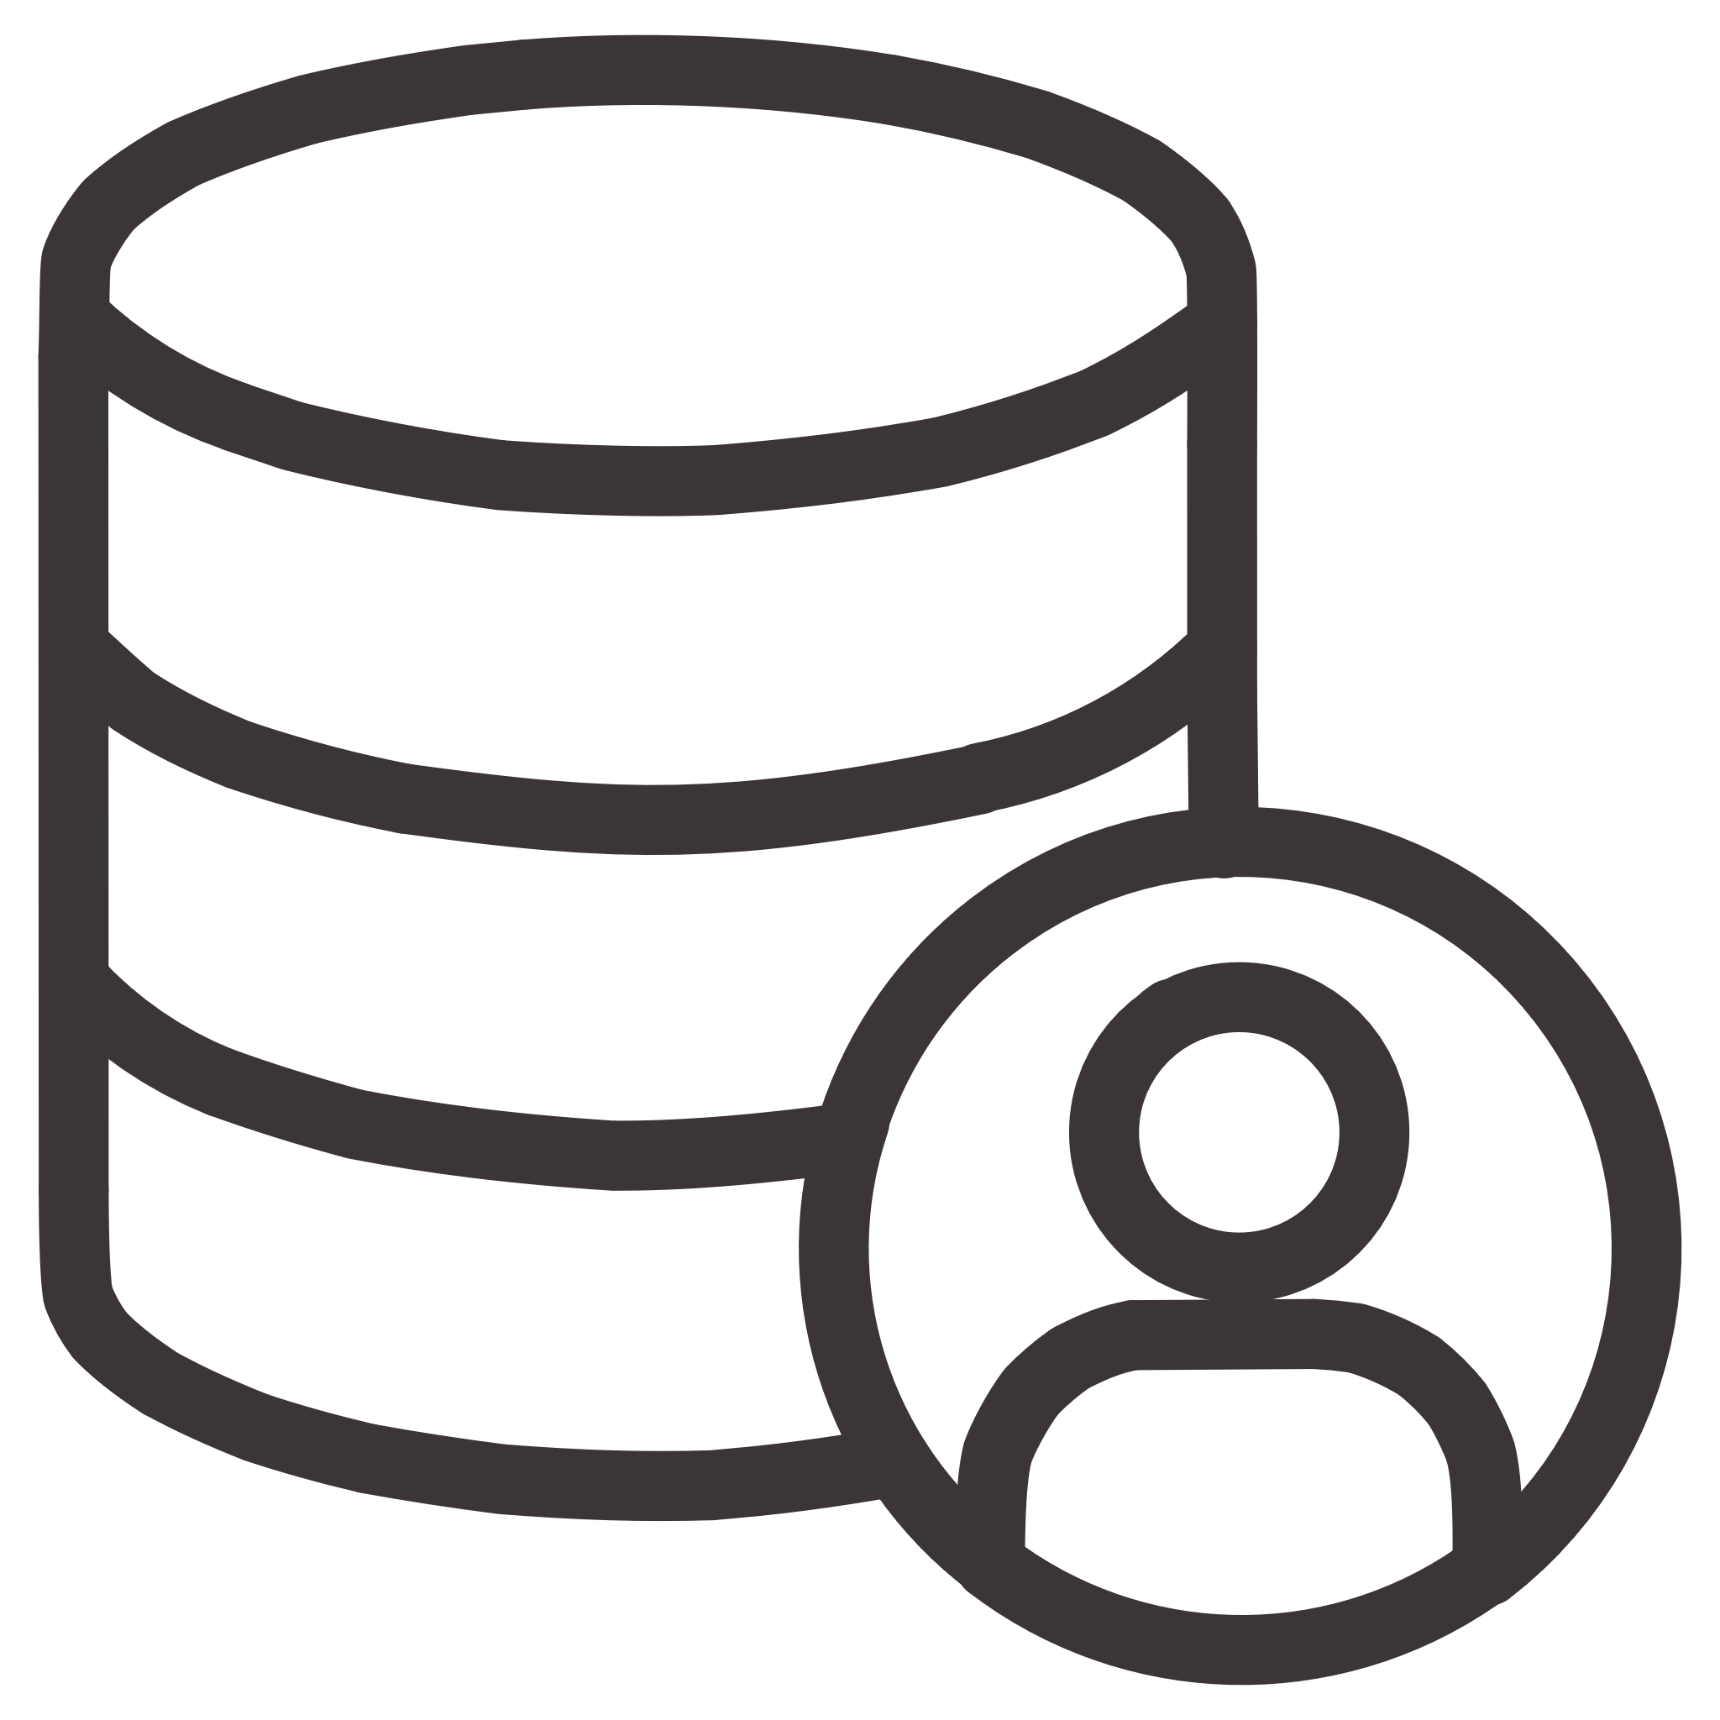




Future Enhancements & Next Steps
Our calorie tracker provides a strong foundation, and we envision several key improvements to expand its functionality and user experience.
Persistent Database
User Authentication
Migrate from CSV/JSON to a robust database for scalable data storage.
Implement a secure login system for personalized tracking.
Nutrition API Integration
Connect to external APIs for a richer, more accurate food database.
Mobile Responsiveness
Optimize the UI for a seamless experience across all devices.
Reporting & Analytics
Add features for tracking progress over time with charts and summaries.

